Slide 1
Clustering

Slide 2
Classification vs. Clustering
Classification: Supervised learning:
Learns a method for predicting the instance class from pre-labeled (classified) instances

Slide 3
Clustering
Unsupervised learning:
Finds “natural” grouping of instances given un-labeled data

Slide 4
Clustering Methods
Many different method and algorithms:
  For numeric and/or symbolic data
  Deterministic vs. probabilistic
  Exclusive vs. overlapping
  Hierarchical vs. flat
  Top-down vs. bottom-up

Slide 5
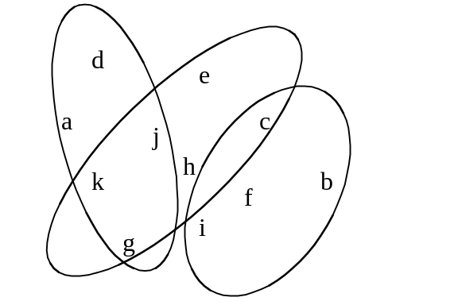
Representing clusters
Non-overlapping
Overlapping
d
e
a
j
c
k
h
b
f
g
i

Slide 6
Representing clusters
Probabilistic assignment
 | 1 | 2 | 3
a | 0.4 | 0.1 | 0.5
b | 0.1 | 0.8 | 0.1
c | 0.3 | 0.3 | 0.4
d | 0.1 | 0.1 | 0.8
e | 0.4 | 0.2 | 0.4
f | 0.1 | 0.4 | 0.5
g | 0.7 | 0.2 | 0.1
h | 0.5 | 0.4 | 0.1
witten&eibe

Slide 7
The distance function
Several numeric attributes:
  Distance(X,Y) = Euclidean distance between X,Y
Nominal attributes: distance is set to 1 if values are different, 0 if they are equal
Are all attributes equally important?
  Weighting the attributes might be necessary

Slide 8
Simple Clustering: K-means
Works with numeric data only
Pick a number (K) of cluster centers (at random)
Assign every item to its nearest cluster center (e.g. using Euclidean distance)
Move each cluster center to the mean of its assigned items
Repeat steps 2,3 until convergence (change in cluster assignments less than a threshold)

Slide 9
K-means example, step 1
k₁
Y
Pick 3
initial
cluster
centers
(randomly)
k₂
k₃
X

Slide 10
K-means example, step 2
k₁
Y
k₂
Assign
each point
to the closest
cluster
center
k₃
X

Slide 11
K-means example, step 3
k₁
k₁
Y
Move
each cluster center
to the mean
of each cluster
k₂
k₃
k₂
k₃
X

Slide 12
K-means example, step 4
Reassign
points
closest to a different new cluster center
Q: Which points are reassigned?
k₁
Y
k₃
k₂
X

Slide 13
K-means example, step 4 …
k₁
Y
A: three points with animation
k₃
k₂
X

Slide 14
K-means example, step 4b
k₁
Y
re-compute cluster means
k₃
k₂
X

Slide 15
K-means example, step 5
k₁
Y
k₂
move cluster centers to cluster means
k₃
X

Slide 16
Discussion, 1
What can be the problems with
K-means clustering?

Slide 17
Discussion, 2
Result can vary significantly depending on initial choice of seeds (number and position)
Can get trapped in local minimum
  Example:
Q: What can be done?
initial cluster centers
instances

Slide 18
Discussion, 3
A: To increase chance of finding global optimum: restart with different random seeds.

Slide 19
K-means clustering summary
Advantages
Simple, understandable
items automatically assigned to clusters
Disadvantages
Must pick number of clusters before hand
All items forced into a cluster
Too sensitive to outliers

Slide 20
K-means clustering - outliers ?
What can be done about outliers?

Slide 21
K-means variations
K-medoids – instead of mean, use medians of each cluster
  Mean of 1, 3, 5, 7, 9 is
  Mean of 1, 3, 5, 7, 1009 is
  Median of 1, 3, 5, 7, 1009 is
  Median advantage: not affected by extreme values
For large databases, use sampling
5
205
5

Slide 22
Other Clustering Approaches
EM – probability based clustering
Bayesian clustering
SOM – self-organizing maps
…

Slide 23
Examples of Clustering Applications
Marketing: discover customer groups and use them for targeted marketing and re-organization
Astronomy: find groups of similar stars and galaxies
Genomics: finding groups of gene with similar expressions
…

Slide 24
Clustering Summary
unsupervised
many approaches
  K-means – simple, sometimes useful
    K-medoids is less sensitive to outliers
  Hierarchical clustering – works for symbolic attributes
Evaluation is a problem

